Slide 1

IBM Cloud Internet Services Web Application Firewall
Global Load Balancer
DDoS Protection
DNS
Rate Limiting

Slide 2







IBM Cloud Internet Services: Web Application Firewall, DNS, Load Balancing, DDoS Protection
Cloud Internet Services, using Cloudflare, ensures network traffic Reliability, Security and Performance at the Network edge
Manages and Secures Internet Facing traffic before it reaches the application, website or API end-point
Available on all IBM Cloud Platform regions
Sign up via IBM Cloud Platform Subscription or Credit Card (No-Cost 30-day trial available)
DDoS Protection: Protect against volumetric, Layer 3 & 4 and Application attacks at Layer 7. Web Application Firewall (WAF)/IP Firewall: Protect applications and websites against both known and new exploits. Transport Layer Security(TLS): Ensure secure data transfers using the latest encryption standards. Rate Limiting: Protect applications and websites against volumetric application and brute force attacks.
Domain Name Server (DNS): Fast resolution of hostnames to their corresponding IP addresses or aliases. Global Load Balancer (GLB): Increase availability by routing traffic across servers based on their availability and service health.
Caching: Provide visitors with location-based access, removing latency and improving performance. Page Rules: Manage granular actions on a web page, create redirects, or fine tuning caching behavior. Smart Routing: Ensure content is delivered on the fastest path from end user to application, website or API.
SECURITY
DDS
RELIABILITY
PERFORMANCE

Slide 3
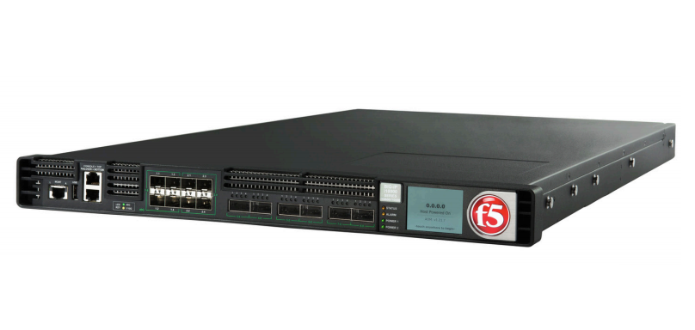
IBM Cloud Internet Services is a Cloud-Native Solution
No appliances, no hardware
Lower cost of setup and management
© 2018 IBM Corporation

Slide 4
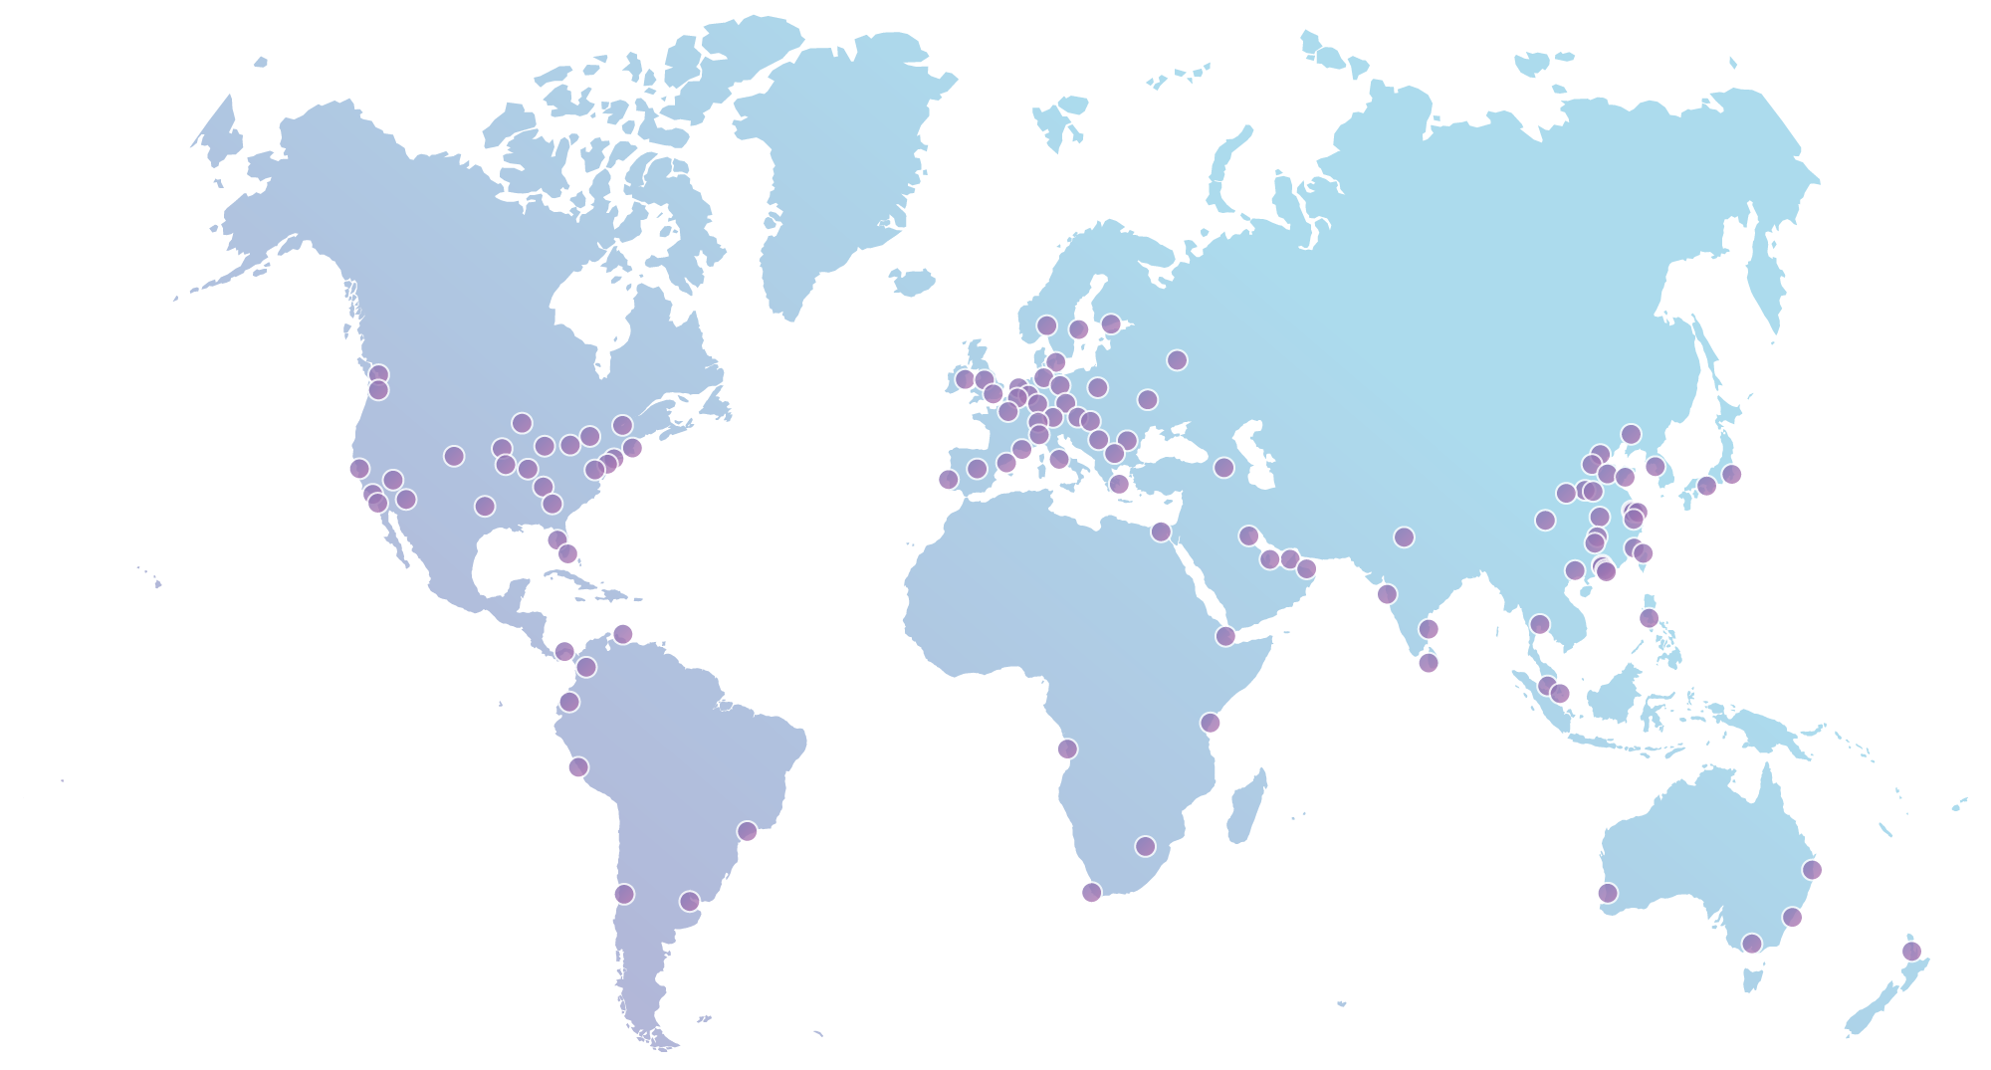
Cloudflare’s Global Anycast Network
25Tbps
10%
capacity
Internet requests everyday
165+
Data centers globally
Speeds up each request by
2x
Notes:
Martijn
We do this with a network of data centers in a 100+ cities across the world, including China
We’ve built an industrial grade network with enough capacity to handle 10% of the internet's requests every day
By seeing 10% of the traffic on the internet each day - it makes our network smarter. We will touch on that in shortly
First, let’s talk about what we do differently...

Slide 5
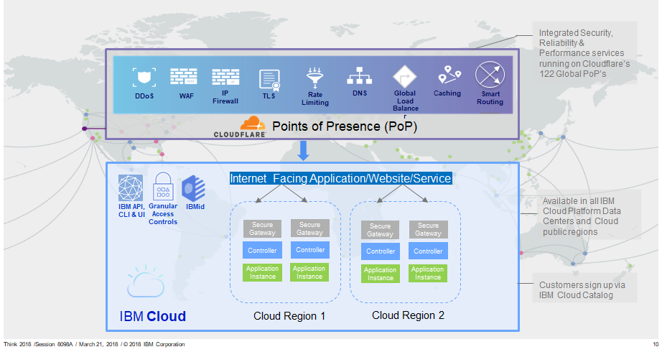
Now Integrated with IBM Cloud
150
Notes:
Anycast/ Reverse Proxy; GRE tunnel not required
Same software in every PoP, “like Southwest point-to-point”
(Haechul: we need to spell out how DNS-based DDoS solutions can solve the limitation of traditional solutions
SOC or ISO Compliance - Sec Compliance
Which ones are most frequent - SOC1 & SOC2
TLS Termination - Cert Options, Cert storage, Encryption paths
FAQ?

Slide 6
Three Compelling Use Cases
Introduce Global Load Balancing
Secure and Optimize APIs and Internet Workloads
Overall Spend Reduction
Add Global Load Balancing to an application which must be highly available, and may already have IBM Local Load Balancer in place
Protect APIs and internet- facing workloads from data theft and Denial of Service (DoS) attacks
Apply consistent policies across hybrid cloud or public workloads, including VMware, Kubernetes, and other environments
Customers can reduce spend collectively by 20% to 80% across security and reliability “edge services,” including DNS, Global Load Balancing, WAF, and Rate Limiting
Notes:
Checkpoint 4 Core Licensing Fees/Year = $32K
Annual OpEx (for MultiCloud) = 1.5 HC (~$150K/year)
Vs
CIS Standard @ $275/domain/mo = $3.3K
OpEx savings (-1.25HC) 0.25 HC = $25K
Net Cost avoidance ~150K/yr

Slide 7
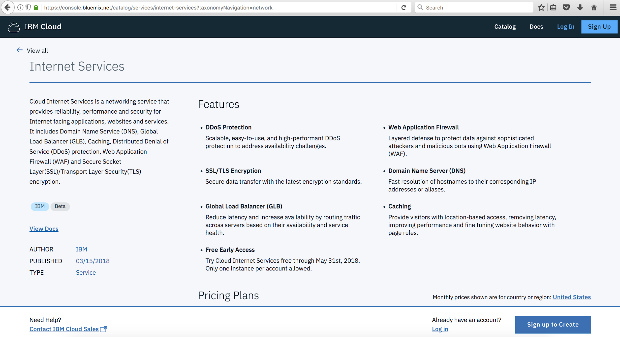
Cloud Internet Services demo!
Login or sign up for IBMid to start

Slide 8
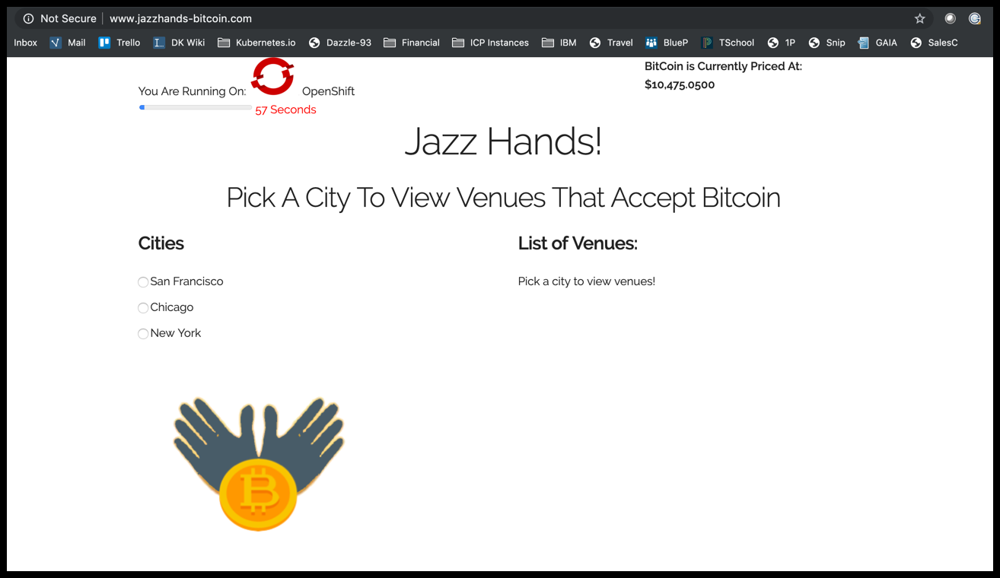
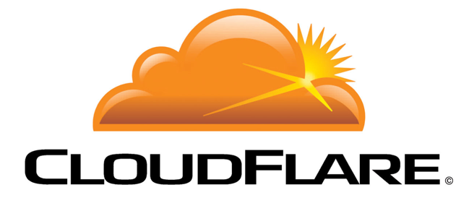
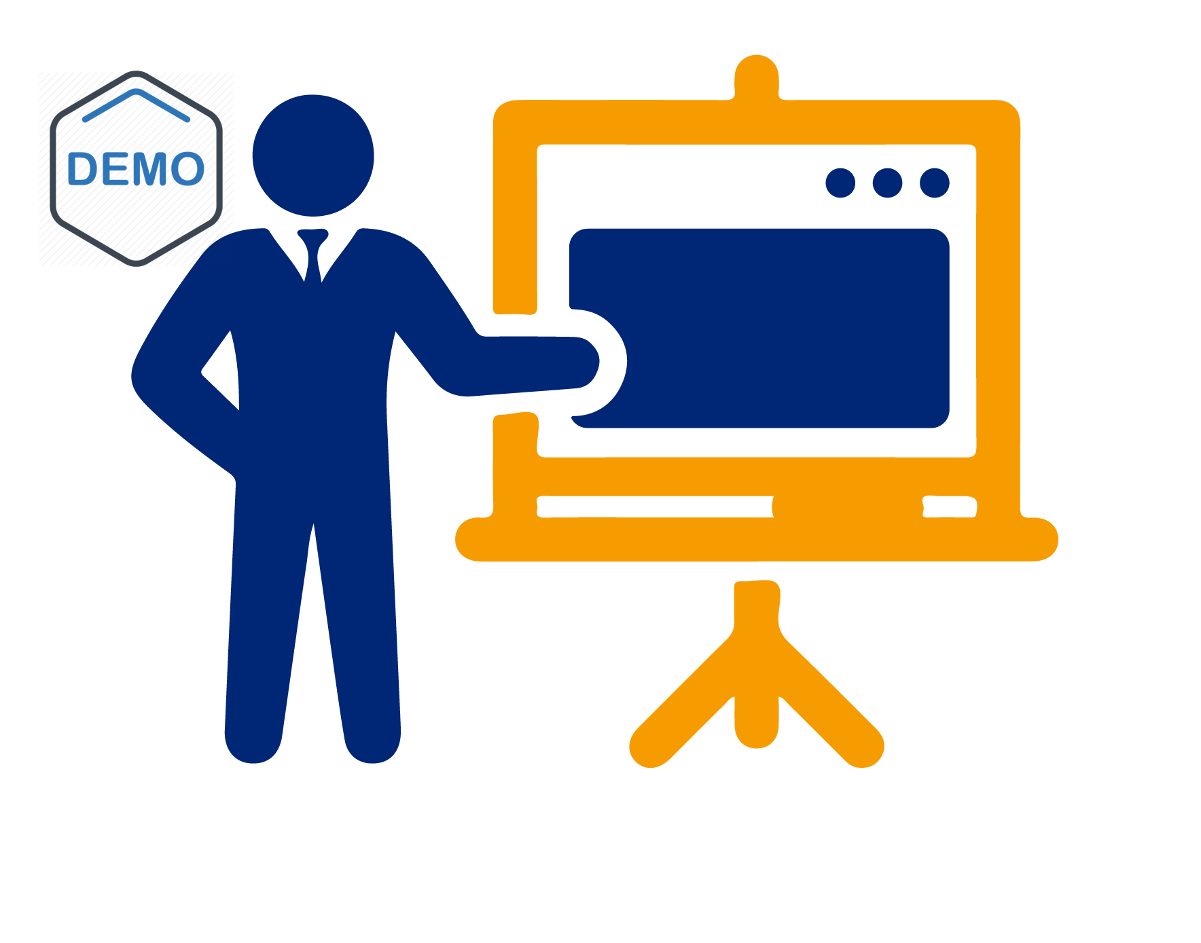
Load Balancer
Platform: IKS
Load Balancer
Platform: OpenShift

